Slide 1
Reinforcement learning based adaptive metaheuristics
Najmieh Sadat Safarabadi Fall-2022

Slide 2
Important Terminology:
Evolutionary algorithm:
Benchmark functions:
Metaheuristics:
Parameter adaptation:
Covariance Matrix Adaptation Evolution Strategies:
Cross Over Rate:
Scale Factor:
Adaptation Policies:

Slide 3
Important Terminology:
The agent in the reinforcement learning
Continuous-Domain Metaheuristic
Step-Size Small Sigma
State-Metrics
Differential Evolution
Differential Evolution Variant like iDE and jDE
Empirical approaches

Slide 4
Important Terminology:
Adaptation policies
Q-learning
Enhance the EA With a Local Search
Policy gradient
Adaptive Mutation
Noisy reward
composite trapezoidal rule

Slide 5
Parameter adaptation, that is the capability to automatically adjust An algorithm’s hyperparameters depending on the problem being faced, is one of the main trends in evolutionary computations applied to numerical optimization.
Here we introduce a general-purpose framework for performing parameter adaption in continuous-domain metaheuristics based on state-of-art reinforcement learning algorithms.
This is done Namely for covariance matrix adaptation evolution strategies (known as the CMA-ES) and differential evolution (DE) for which we learn respectively, adaptation policies for the step-size (for CMA-ES) and the scale factor and the crossover rate (for DE)

Slide 6
CCS concepts: optimization with randomized search heuristics
The performance of the metaheuristics typically depends on their hyper-parameters. Finding those parameters before performing an optimization process through trial-and-error or other empirical approaches is usually tedious and obviously suboptimal.

Slide 7
Another possibility is to endow the metaheuristics with a parameter adaption strategy.
Several handcrafted policies have been proposed over the years to address parameter adaption.
However, finding an optimal adaption policy is in turn challenging as different policies may perform differently on different problems or during different stages of an optimization process.

Slide 8
It is possible to cast the search for an adaption policy as a reinforcement learning (RL) problem where the agent observes the state of the optimization process and decides how to change the parameters accordingly.
This is mostly due to the fact that the observation space of an optimization process can be quite large, and finding relevant state optimization process and finding relevant state metrics (i.e inputs to the policy) and rewards can be difficult.

Slide 9
The Goals of This Research
In this paper the goal is to introduce a general-purpose framework for performing parameter adaption in continuous-domain metaheuristics.
One reason for building such a framework is to relive algorithm designers and practitioners from the need for building handcrafted adaption strategies.
On top of that, using such framework would allow to use pretrained strategies and apply them to new optimizations problems.

Slide 10
In this paper we focus on two well-known successful handmade adaption policies that exists.
In case of CMS-ES we train an adaption policy for the step-size small Sigma.
In case of DE, we instead adapt the scale factor F and the crossover rate CR.
we train these policies on a set of 46 benchmark functions at different dimensionalities with various state metrics.

Slide 11
A Quick Review
Global Policy for all functions
Cumulative Step-Size Adaption
Well-known Adaptive Differential Evolutions Variants

Slide 12
In Two Settings:
One policy per function
And one global policy for all functions.
Compared respectively to the cumulative step-size adaption (CSA) policy and to two well-known adaptive DE variants (iDE and jDE) our policies are able to produce competitive results, especially in case of DE.

Slide 13
The background of this research:
In the context of DE several works have shown the effects of using an adaption strategy to choose F and CR.
These parameters are in fact known to affect both diversity and optimization results.
For instance, some authors proposed using pools for different parameters and mutation for DE with different approaches for controlling its parameter.
The authors of [10] proposed instead an improvement on shade [31] which uses proximity-based local information to control the parameter settings.

Slide 14
Rather than engineering the parameter adaption strategy, some studies have tried to learn metaheuristics with RL.
Some of these works are based on Q-learning.
for example, li et all [19] considered each individual as an agent that learns the optimal strategy for solving a multi-objective problem with DE
in a similar way, hu et al [12] used a Q-table for each individual to choose how much to increase/decrease the F parameter during a DE run to solve circuit design problems.

Slide 15
sallam et al [22] proposed an algorithm that evolves two populations:
one with CMA-ES and
one with Q-table
in order to choose between different DE operators and enhance the EA with a local search.
Other approaches are based on deep RL: For example, shrame et al [26] proposed a method that uses deep RL that produces an adaptive DE strategy based on the observation of several state metrics.
sun et al [28] trained a long-short memory (LSTM) with policy gradient to control the F and CR parameters in DE.

Slide 16
shala et al [25] trained a neural network with guided policy search (GPS) to control the step-size of CMA-ES by also sampling trajectories created by cumulative step-size adaptions (or CSA)
lacerda et al [16] used distributed RL to train several metaheuristics with twin delayed deep deterministic policy gradients [9].
The Methods used in this research
The proposed framework is used to learn a policy that is able to set the parameters of an EA at each generation of the optimization process.

Slide 17
In the proposed framework in this paper there is similar approach presented in [25] however it is different from [25] in a way that:
It does not use GPS as RL algorithm and most importantly we do not partially sample the parameter adaptation trajectory from an existing adaption strategy in [25] in CSA)
But rather we build the adaption trajectory from scratch entirely based on the trained policy.
Another important aspect is that our framework can be configured with different EAs in RL algorithms and can very easily extended in terms of state metrics, actions and rewards.

Slide 18
The evolutionary algorithm section: in this paper it is tested the framework using CMA-ES and DE since these are two well-known EAs for which several studies exist on parameter adaption.
in this comparison two well-established adaption strategies taken from the literature: for CMS-ES cumulative step-size adaption (CSA) and for the de, iDE and jDE more details on these adaption strategies will follow.
covariance matrix adaptions evolution strategies or CMA-ES: conduct the search by sampling adaptive mutations from a multivariate normal distribution (x𝑖 ∼ 𝒎 + 𝜎 × n (0, 𝑪)))

Slide 19
(x𝑖 ∼ 𝒎 + 𝜎 × n (0, 𝑪)))
At each generation, the mean m is updated based on a weighted average over the population,
While the covariance Metrix C is updated by applying a process similar to that of principle component analysis.
The remaining parameter 𝜎 is the step size, which in turn is adapted during the process.
Usually, 𝜎 is self-adapted using CSA [4]
In our case the policy is learned and computed based on an observation of the current state of the search.

Slide 20
differential evolution or DE is very simple yet efficient EA.
Starting from an initial random population at each generation the algorithm applies on each parent solution a differential mutation operator, to obtain a mutant which is then crossed over with the parent.
This while there are different mutation and crossover strategies for DE.
In the current paper we consider only the “best/1/bin” strategy.

Slide 21
according to the “best/1/bin” strategy the mutant is computed as:
𝒙 pow( 𝑘+1) = 𝒙 pow(𝑘) 𝑏𝑒𝑠𝑡 + 𝐹 × (𝒂−𝒃);
Where 𝒙 pow(𝑘) 𝑏𝑒𝑠t is the best individual at the k-th generation
a and b are two mutually exclusive randomly selected individuals in the current population, and F is the scale factor.
The binary crossover, on the other hand, swaps the genes of parent and mutants with probability given by the crossover rate (or CR).

Slide 22
without the adaption, F and CR are fixed. in our case we make the policy learn how to adapt them by using two different approaches:
these are directly updating F and CR with the policy
or sampling F and CR from a uniform/normal distribution parametrized by the policy.
Reinforcement learning setting in this research: the model chosen in this paper, as for the RL setting we chose the same model used in [25]:2 fully connected hidden layers of 50 neurons each (thus with 50*50 connections) with Relu activation function.

Slide 23
Insert a sample of fully connected neural network

Slide 24
The size of the input layer depends on the observation space, while the size of the output layer depends on the action space.

Slide 25
The learning setting: proximal policy optimization we chose proximal policy optimization (or ppo) to optimize the policy due to it’s good performances in general-purpose RL tasks.
in the setup, n = 1, k = 200 and the other parameters are set as per their defaults value used in the ray-rllib library.
theta is the parameters of the policy in our case the weights of the neural networks.

Slide 26
L is the loss function
a caret t is the advantage estimate at iteration t
observation spaces section, we experimented with observation spaces, each one defined as a set of state metrics.
a state metric computes the state (or observation) of the model based on various combinations of fitness values, genotypes, and other parameters of the EA.
more specifically we used this state metrics: inter-generational delta f

Slide 27
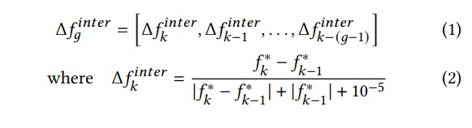
inter-generational delta f means for the last g generations, we take the best fitness in the population at each generation and compute the normalizations differences with the best fitness at the previous generation.
In this formula f* k is the best fitness value in the population at the k-th generation.

Slide 28

In this way, is proportional to the best fitness from the previous generation, saturation to – and + for the f* => infinite
###############

Slide 29
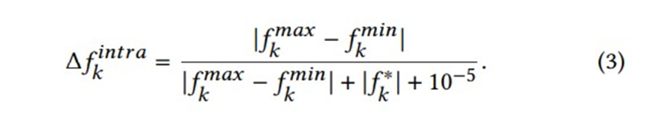
The constant 10 pow(-5) is needed to avoid divisions by zeros.
The normalization of delta F is fundamental to have stable training.
intra generational delta f: for the last g generations,
we take the normalized differences between the maximum and minimum fitness of the current population at each generation.

Slide 30
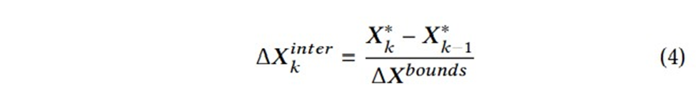
Inter-generational delta x: similarly, to the inter-generational delta f, the normalized difference between the best genotype in two consecutive generation are take for the last g generations.
in this case to maintain linearity, the normalization is done using the bounds of the search space.
In this formula the x star k is the genotype associated to the best fitness at generation k
and delta x bounds = [delta x bounds 1,…, delta x bounds d] is the vector containing, for each variable, the bounds of the search space being D the problem size.

Slide 31

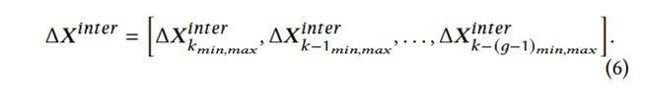
since the size of this observation would depend on the problem size, the policy would work only with problems of fixed size. To solve this problem, we use as observation the minimum and maximum values of delta x inter k
The intra-generational delta x is then defined as a history of the above defined metric at the last g generations:

Slide 32
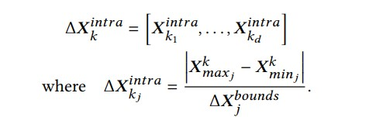
intra-generational delta x: given x k ij as the j-th dimension of the i-th individual of the population at the k-th generation, the intra-generational delta x at the k-th generation is defined as:

Slide 33


in this case we use as observation the minimum and maximum values of the delta x intra k:
the intra-generational delta x is then defined as a history of the above defined metrics at the last g generations:

Slide 34
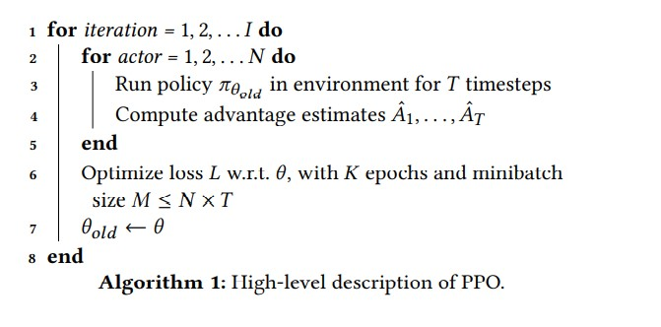
in all the experiments, we always include in the observation space also the previous model output. the parameters given by the model in the previous generation.

Slide 35
Action space section of this research:
the action space of the policy depends on both the specific EA and the approach used to parametrized it.
in our model, the action is taken at every generation, using the observation from the previous one.

Slide 36
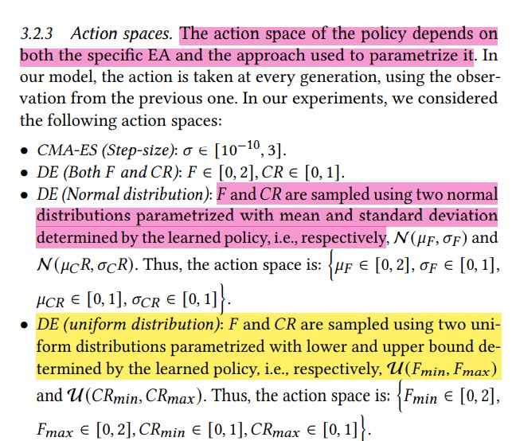
in our experiments, we considered the following action spaces:

Slide 37
Reward section: the reward is a scalar representing how good or bad was the performance of the policy during the training episodes.
the use of this reward brings some advantages: it reflects the progress of the optimization process
maintaining the independence with different scales of the objective functions, and it yields better numerical stability during the training process.

Slide 38
the training procedure in this research: in this paper we consider two policy configurations and those are the single-function policy and the multi-function policy. the model is trained separately on each function.
in this way, the policy specializes for each single optimization problem.
in the second configuration, the model is instead trained using the evolutionary runs on multiple functions.

Slide 39
quite surprisingly with this procedure we could obtain policies that are able to work better than the adaptive approaches from the literature.
in all our experiments, we trained the models for 5000 function evolutionary runs (i.e episodes)
each consisting of 500 function evaluations
hence meaning 2.5 * 10 pow(6) function evaluation per each policy training.

Slide 40
Evaluation section: the bench mark functions, the experiments have been done with 46 benchmark functions taken from the bbob benchmark [8]
for each function we used default instance i.e without random shift in the domain or codomain

Slide 41
Description about benchmark functions:
bentcigar, discus,
ellipsoid,
katsura,
rrastrigin, rosenbrock, schaffers, schwefel, sphere, weiestrass, all in 10 dimensions.
The remaining 36 functions are the same 12 functions namely:
attractiveSector,
BuencheRaastring,
CompositeGR,
DiffrenetPowers,
LinearSlope, SharpRidge, StepEllipsoidal, RosenbrockRotated, SchaffersIIIConditioned, LunacekBir

Slide 42
The 46 functions are selected as follows:
the first 10 functions are: bentcigar, discus, ellipsoid, katsura, rrastrigin, rosenbrock, schaffers, schwefel, sphere, weiestrass, all in 10 dimensions.
The remaining 36 functions are the same 12 functions namely: attractiveSector, BuencheRaastring, CompositeGR, DiffrenetPowers, LinearSlope, SharpRidge, StepEllipsoidal, RosenbrockRotated, SchaffersIIIConditioned, LunacekBir, GG101me and GG21hi each one 5, 10 and 20 dimensions.

Slide 43

compared method section of the paper =
we compared the learned policies with the following adaptive methods:
cumulative step-size adaption [4: CSA is considered the default step-size control method of CMA-ES]
to compute small delta (t plus one)
A cumulative path is defined as:

Slide 44


where C is a member with range [0,1]
1/c represents the lifespan of the information contained in p(t)
here the represents the best children at the t-th generation.
The step-size is defined as where the d small delta is the damping parameter that determines how much the step size can change (this is usually d small delta =1)

Slide 45

Ide: the ide adaptive method maintains a different F and CR for each individual and updates them with a different rule that depends on the mutation/crossover strategy that is used.
In our DE experiments we use the best/1/bin strategy and the considered iDE updates rules are:

Slide 46
in this formula F(best) and CR(best) are the F and CR values corresponding to the best individual and F(rt) or the CR(rt) is a random F (OR CR) sampled from the best F or CR) values
until the current generation ( is needed to selected mutually exclusive values for each individual)

Slide 47

in the step 3 jDE [1]: jDE is a simple but effective adaptive DE variant. with probability p=0.1 the method samples F from

Slide 48
evaluation metrics section of the paper:
in order to compare the different setup of algorithms and models, we consider two metrics
the area under the curve (or AUC):
during each evolutionary run, the minimum fitness of the population at each generation is stored.
the result is a monotonic non-increasing discreet function such as summing elitism
the area under this curve is then calculated using the composite trapezoidal rule. This metric is a good indication of how fast the optimization process is.
the best of run:
the best fitness found during the entire optimization process.
as we assume minimization of the objective function for both metrics it holds that the lower their values the better is the performance of a policy.

Slide 49
the testing procedure section of the paper: given a RL based trained policy pi(a)
and an adaptive policy pi(b) taken from it’s literature (e.g CSA) that take actions

Slide 50

on the corresponding ea (e.g CMA-ES), the two policies are tested in the following way:
we take the policy pi(a) and execute 50 runs
each one for 50 generations with a population of 10 individuals. thus, every run has 500 function evaluations
we do the same for policy pi(b)
for each run of both policies, we compute the two metrics
these two metrics are AUC and best of run
for both metrics we calculate the probability that pi(a) performs better than pi(b) as:

Slide 51
where :
is 1 (one) if the metric of pi(a) on the i-th run is less than the metrics of pi(b) on the j-th run otherwise, it is 0 (zero)

Slide 52
The result section of the research: separating the experiment with CMS-ES from those with DE.
The CMA-ES experiments section of the paper:
comparison between PPO and GPS:
the first experiment was done with CMA-ES and single-function training, trying to configure the model as similarly as possible to [25], in order to get a first comparative analysis

Slide 53
However, a direct comparison with the results reported in [25] was not possible
In fact the authors of [25] used GPS as training algorithm that is not implemented in the ray-rllib library. To avoid replicability issues, we then decided to train our model using the available PPO implementation from ray-rllib library.
Furthermore, we did not use the sampling rate technique implemented in [25]
For example, in our case the trajectories of the step-size are taken entirely from the trained policy.
The rest of the setup is the same used in [25] and as mentioned earlier, we used 2 fully connected hidden layers of 50 neurons each with Relu.

Slide 54
The observation space is: differences between successive fitness from 40 previous generations which are not normalized
The step-size history from 40 previous generations
The current cumulative path length (equation from [25])
The reward is the negative of the fitness (not normalized)
The action space is small theta in range [0.05, 3]
Please note that these state metrics and reward are different from the ones described in section 3.2

Slide 55
the mentioned reward have been used only in this preliminary experiment for comparison with the results from [25]
in this paper we performed this experiment only with the first 10 functions of the considered benchmark. The result of this experiment was quite poor.
the single function trained policy obtained better testing results than CSA (p(pi< CSA)) with both AUC and best of run metrics only on 2 functions.

Slide 56
We found that the main reason for this scarce performance is the noisy reward.
the scale of the fitness differs across multiple runs and PPO is sensible to the reward scale.
This seems to explain why the authors of [25] chose GPS which is robust to different reward scales.
note: with this setup we encountered numerical instability problems

Slide 57
with bentcigar, rosenbrock and schaffers we have not been able to train the policy because at a certain point of the training process the weights of the model become nan.
this is very likely caused by the noisy reward which makes some gradient or loss function value go to infinity.
the problem above was solved using a normalized reward.

Slide 58
Normalizing the rewards section of the paper:
in the project we tried to improve the previous setup by normalizing the reward and using a minimal observation space.
the reward in this case is the one explained in sections 3.2.4
the observation space is the inter-generational delta F with G = 40

Slide 59
and the step-size of the previous generation
testing the policy on all the 46 functions
it did better than CSA on 30.4% (14/46) of the functions
on the top of that, we did not have training stability issues. overall, we found that CSA is a very good step-size adaptation strategy and it is difficult to do better by means of RL.

Slide 60
a more intensive experimentation with DE: here a more intensive experimentation has been conducted with DE.
we started with single-function training policies and training one model per function.
then we experimented with multi-function training applying small changes in the model in order to get close to the single-function results.
single-function policy: in this paper we report that the result of the single-function policies using three action spaces to parametrize DE and compare them with iDE and jDE

Slide 61
this causes a noisy reward that can lead to numerical instabilities during the training process.
to solve this problem, it is necessary to design a custom loss function for the train algorithm.
but this would mean to use a variation of PPO which falls outside the scope of this work where we are limiting ourselves to using the original PPO.
a simple workaround was to run the training process multiple times in most cases one or two attempts were enough to train the policy without encounter this instability problem.

Slide 62

plus, to this we observed that using the hyperbolic tangent as activation function instead of Relu can help reduce the probability to encounter instabilities.
the left-most figure 1 shows the percentage of he functions where the learned policy did better than iDE/jDE over the total number of functions:

Slide 63
it can be seen that the uniform distribution strategy gives the best results overall.
but there are a few functions where the adaptive strategies provide by iDE and jDE always do better.
multi-function policy: after seeing the results of the normal and uniform distribution approaches in the single-function setting in this paper they experimented with multi-function training using one policy trained for 5000 episodes on all the 46 functions.

Slide 64
All the policies have at least the inter-generational delta F and the values of the precedent action as observation.
the entries on the rightmost side of the figure2 starting with “w” denote what is include in the observation space.
On top of this we also tried to double the number of training episodes “double training labels” and increase the size of the model to 100 * 50* 10 which means “bigger net” label.

Slide 65
for brevity we report only the result of the best of run metric
green (red) cells indicate that the trained policy pi works better (worse) than the corresponding adaptive DE variant (thus either iDE or jDE) with pi trained separately and tested on each function.
darker green (red) indicates higher (lower) probabilities.
black cells indicate that the policy could not be trained due to numerical instability issues:
in fact DE due to it’s random nature is likely to produce different fitness trajectories across evolutionary runs.

Slide 66
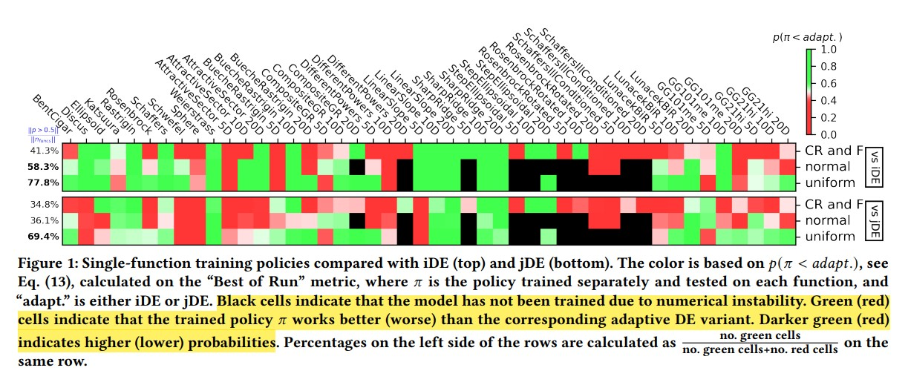
The result of single function training policy

Slide 67
One of the main results that can be noted from figure 2 is the different performance between the normal and the uniform distribution approaches.
The latter is visibly superior with respect to the former.
And it gets very close to the single-function training performance shown in figure 1 by only adding the intra-generational delta F to the observation space.
The normal distribution approaches over comes iDE and jDE only by both adding intra-generational delta and delta x to the observation space and increasing the model and it’s training time.

Slide 68
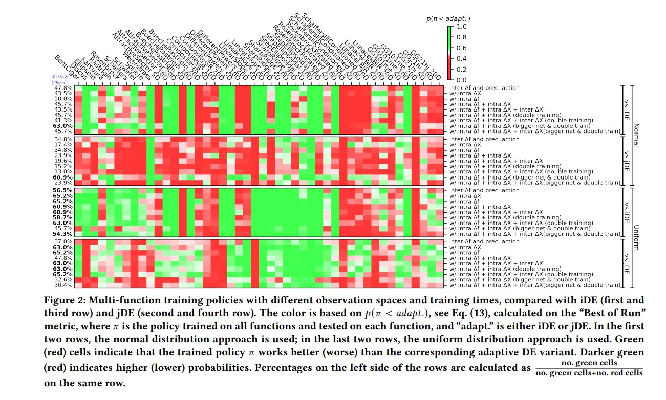
the last means 108 evolutionary runs per function.
we trained and compared 9 versions of the model with different observation spaces combining the state metrics defined previously. The results of this experiment are shown in figure 2.

Slide 69
this suggest the facts that this approach could work but it is more difficult to train.
another consideration may be that in order to get a better balance between exploration and exploitation, F and CR must be highly variant, especially at the end of the evolution.
another important observation can be made looking at figure 3 because they are very similar across the functions. but the same pattern is present on all the multi-function training policies.
this problem limitation for the policy because being able to make different choices depending on the function is crucial if we want to have true adaptation.

Slide 70
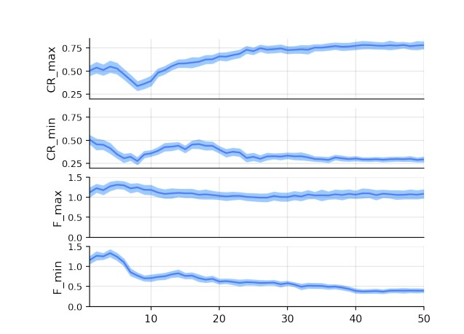
Figure 3 also shows that the model has learned a general policy that works well for the majority of the functions and that this is in line with the common strategy of exploring during the first phase and exploitation during the last phase.
in fact, during the evolution, CR which determines the effect of the crossover, is initially small and within a small range (𝐶𝑅𝑚𝑎𝑥 and 𝐶𝑅𝑚𝑖𝑛 are < 0.5 and similar)
while at the end it increases its variance (𝐶𝑅𝑚𝑎𝑥 = 0.75 and 𝐶𝑅𝑚𝑖𝑛 = 0.25).
instead, F which determines the effects of mutation is initially high with low variance.
(both 𝐹𝑚𝑎𝑥 and 𝐹𝑚𝑖𝑛 are ∼ 1) and at the end it has high variance between ∼ 1 and ∼ 0.5.

Slide 71
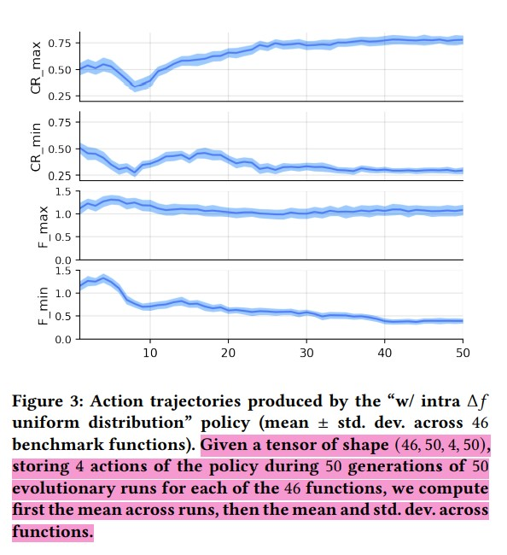
another important observation can be made looking at figure 3 because they are very similar across the functions.

Slide 72
This is figure 3 represent the trajectories produced by the “w/ intra δ𝑓 uniform distribution” policy.
goven a tensor of shape (46, 50, 4, 50), storing 4 actions of the policy during 50 generations of 50 evolutionary runs for each of the 46 functions
We compute first the mean across runs then the mean and std.dev.across functions. (mean ± std. dev. across 46 benchmark functions)

Slide 73
one possible cause of this problem may be the small capacity of the model in terms of number of layers or the number of the neurons or the number of episodes. but increasing both at least to the values that we tested did not bring any improvement.
a possible solution may be to add a loss function in an intermediate layer the same as the one googlenet does to classify the function in some manner like the unimodal and multimodal but this would increase the computational cost.

Slide 74

Summary and The Results of This Research

Slide 75
in this paper a new python framework is proposed for learning parameter adaptation policies in metaheuristics.
the framework based on a state-of-the-art RL algorithm (PPO) is of general applicability and can be easily extended to handle various optimizers and parameters thereof.
in the experimentation in this paper the proposed framework is applied for learning the step-size in CMA-ES and the scale factor and crossover rate in DE.
the experiments demonstrate that efficacy of the learned adaptation policies, especially considering the best of run results in the case of DE in comparison with well-known adaptation policies taken from the literature such as ide and jDE
the hybridization of metaheuristics and RL to which this paper contributes is becoming growing field of research

Slide 76
and offers the potential to create genuinely adaptive numerical optimization techniques with the possibility to perform continual learning and incorporate previous knowledge.
in this regard this work can be extended in multiple ways
the most straightforward direction would be to test alternative rl models different from ppo.
plus while in this study we focused on real-valued optimization, in principle the proposed system could be extend to handle parameter adaptation also for solving combinational problems.

Slide 77
furthermore, it will be important to test the proposed framework in real-world application and include comparative analysis other state-of-art optimizers.
moreover, it would be interesting to investigate alternative observation spaces and reward functions.
another option would be to extend the framework to learn the choice of operators and algorithms rather than their parameters.

Slide 78

Thank you

